Slide 1
CSC222: Computer Organization & Assembly Language
7 – Processor Status & Flags
Instructor: Anwar khan

Slide 2
The FLAG Register
Nine individual bits called as flag are used to represent the 8086 processor state.
Flags are placed in FLAG Register.
Two types of flags:
  Status Flags: Reflects the result of a computation. Located in bits: 0, 2, 4, 6, 7 and 11.
  Control Flags: Used to enable/disable certain operations of the processor. Located in bits 8, 9 and 10.
Notes:
Special purpose register size 1 byte or 2 byte.
Depending upon the value of result after any arithmetic and logical operations the flag bit become (1) or (0).

Slide 3
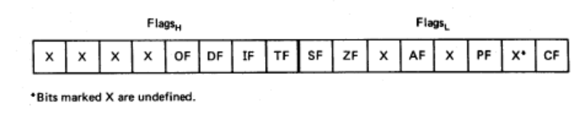
Flags
Carry flag
Overflow
Direction
Parity flag
Interrupt enable
Auxiliary flag
Trap
Zero
6 are status flags
3 are control flag
Sign

Slide 4
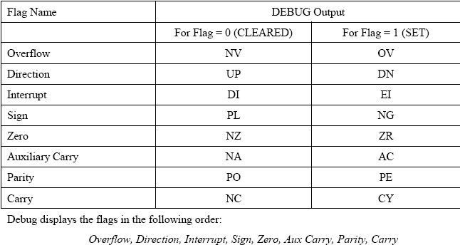

Slide 5
The Status Flags
1. Carry Flag:
  Set (CY), Unset (NC)
  The Carry Flag is set to 1 when there is a carry out from MSB on addition or there is a borrow into the MSB on subtraction. Also affected by shift and rotate instructions.
  Examples:
  0FFh + 11h = 110h (If a register can store only 1 byte, then where to store the carry generated by MSB?)
  1000 0001b – 1000 0010b = 11111111b (How processor would know a borrow is required to perform subtraction?)

Slide 6
Contd..
2. Parity Flag:
  Set (PE), Unset (PO)
  PE (Even Parity): If the low byte of a result has an even number of one bits. For Even parity, PF =1
  PO (Odd Parity): If the low byte of a result has odd number of one bits. For Even parity, PF = 0
  Examples:
  1000 0001b – 1000 0010b = 11111111b (Number of one’s in result = 8, so PF = 1)

Slide 7
Contd..
3. Auxiliary Carry Flag:
  Set (AC), Unset (NA)
  The Auxiliary Carry Flag is set to 1 if there is a carry out from bit 3 on addition, or a borrow into bit 3 on subtraction.
  Used in Binary Coded Decimal (BCD) Operations.
  Examples:
  1000 0001b – 0000 0010b = 01111111b (Borrow from bit 4 to bit 3)

Slide 8
Contd..
4. Zero Flag:
  Set (ZR), Unset (NZ)
  Zero Flag is set when the result is zero.
  Zero Flag is unset when result is non zero.
  Examples:
  0FFh – 0FFh = 00h

Slide 9
Contd..
5. Sign Flag:
  Set when MSB of a result is 1; it means the result is negative (signed interpretation)
  Unset when MSB is 0 i.e. result is positive.
  Examples:
  0FFh – 0FFh = 00h (MSB = 0, PF = 0)

Slide 10
Contd..
6. Overflow Flag:
  Set (OV), Unset (NV)
  Set if signed overflow occurred, otherwise it is 0.
Overflow:
  Range of numbers that can be represented in a computer is limited.
  If the result of an operation falls outside the defined range, Overflow occurs and the truncated result will be incorrect.
Four possible outcomes of an arithmetic operation:
  No Overflow
  Only Signed Overflow
  Only Unsigned Overflow
  Both Signed and Unsigned Overflow

Slide 11
Contd..
Example of Unsigned Overflow Only:
  AX = FFFFh, BX = 0001h
  ADD AX, BX
  Result: AX = 0000h but the correct answer is 10000h
  But FFFFh = -1 and 0001h= 1, -1+1 = 0 so the stored answer is correct if consider signs as well. Therefore, no sign overflow occurred.

Slide 12
Contd..
Example of Signed Overflow Only:
  AX = 7FFFh, BX = 7FFFh
  ADD AX, BX
  Result: AX = FFFEh (correct unsigned result, so unsigned overflow)
  7FFFh = 32767,
  32767 + 32767 = 65534, which is out of ranged for signed numbers, also FFFE = -2 so signed overflow occurred.

Slide 13
How the Processor indicates overflow?
The Processor sets:
  Overflow Flag = 1 for Signed Overflow
  Carry Flag = 1 for Unsigned Overflow

Slide 14
How the Processor determines that overflow occurred?
Unsigned Overflow:
  Addition: Carry out from MSB
  The correct Answer is largest than the biggest unsigned number FFFFh for a word and FFh for a byte.
  Subtraction: Borrow into MSB
Signed Overflow:
  Addition: Same sign but sum has a different sign (e.g.: when you add two positive numbers and answer is negative)
  Subtraction: If result has different sign than expected
In Addition/Subtraction of two numbers with different signs, overflow is impossible. E.g.: A + (-B) = A – B

Slide 15
How Instructions Affect the Flags
Instructions | Affects Flags
MOV/XCHG | None
ADD/SUB | All
INC/DEC | All except CF
NEG | All (Carry Flag = 1 unless result is 0, Overflow Flag = 1 if word operand is 8000h, or byte operand is 80h

Slide 16
Example 5.1
ADD AX, BX, where AX contains FFFFh, BX contains FFFFh
Solution:
  Actual Result = 1FFFEh
  Result stored in AX = FFFEh
  Flags:
    SF = 1 because the MSB is 1
    PF = 0 because there are 7 (odd number) of 1 bits in the low byte of the result.
    ZF = 0 because nonzero result
    CF = 1 because there is a carry out of the MSB on addition
    OF = 0 because the sign of the stored result is the same as that of the numbers being added (in binary addition, there is a carry into the MSB and carry out from MSB also)

Slide 17
Example 5.2
ADD AL, BL where AL contains 80h, BL contains 80h
Solution:
  Actual Result = 100h
  Result in AL = 00h
  Flags:
    SF = 0 because MSB is 0
    PF = 1 because all bits in result are 0
    ZF = 1 because result is 0
    CF = 1 because there is a carry out from MSB
    OF = 1 because the numbers being added are both negative but the MSB in result is 0 (in binary addition, there is a no carry into the MSB but there is carry out from MSB.

Slide 18
Example 5.3
SUB AX, BX where AX contains 8000h and BX contains 0001 h
Solution:
  Actual Result = Result in AX = 7FFFh
  Flags:
    SF = 0 because MSB is 0
    PF = 1, Parity is Even because there are 8 one bits in the low byte of the result
    ZF = 0 because result is nonzero
    CF = 0 because a smaller unsigned number is being subtracted from a larger one
    OF =1 because we are subtracting a positive number from a negative number but the result is positive (wrong sign of result)

Slide 19
Example 5.4
INC AL where AL contains FFh
Solution:
  Actual Result = 100h
  Result stored in AL = 00h
  Flags:
    SF = 0
    PF = 1
    ZF = 1
    CF = 0 because CF is unaffected by INC
    OF = 0 because number of unlike sign are being added (there is a carry into the MSB and also carry out from the MSB)

Slide 20
Example 5.5
MOV AX, -5
Solution:
  Result in AX = -5 = FFFBh
  None of the flags are affected by MOV

Slide 21
Example 5.6
NEG AX where AX contains 8000h
Solution:
  Result in AX = 8000h (2’s complement)
  SF = 1
  PF = 1, in low byte of result, number of 1 bits is 0.
  ZF = 0
  CF = 1 because for NEG, CF is always 1 unless the result is zero
  OF = 1 because there is no sign change

Slide 22
Program
ORG 100h
.CODE
MOV AX, 4000h ; AX = 4000h
ADD AX, AX ; AX = 8000h
SUB AX, 0FFFFh ; AX = 8001h
NEG AX ; AX = 7FFFh
INC AX ; AX = 8000h
MOV AH, 4Ch
INT 21H

Slide 23
Control Flags
Direction Flag: Controls the assumed direction used by string processing instructions. 1=Up, 0=Down
Interrupt Flag: Enable/Disable external interrupt.
Trap Flag: Determines whether or not CPU will be halted after each instruction.

